Slide 1
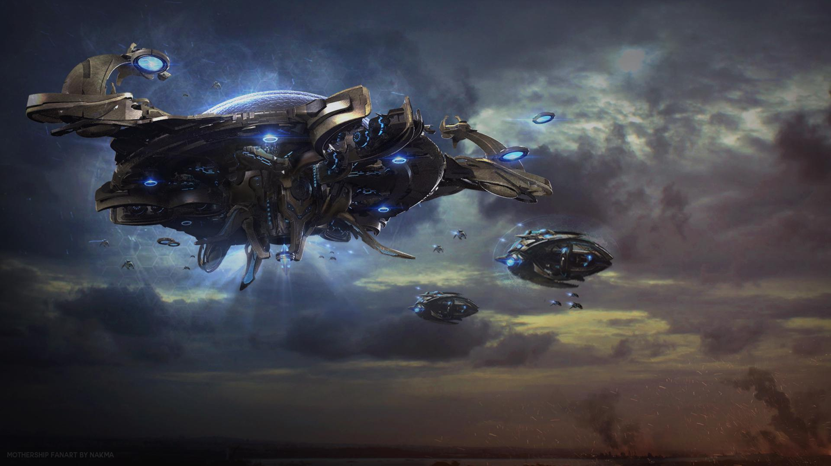
Elevator pitch
In a fictional 2021,
Original assassins creed but in space, Assassins creed 4 elements where its open world with a pirate ship, but in this case its 'openspace' with a 'space' ship.
Your a space pirate in this game.
You hunt down other space pirates in your Flying dutchman, butchering and plundering.
The goal is to travel the galaxy in hopes of finding legendary treasures lost in time.

Slide 2

Gameplay description
Play as a free roaming space pirate, kill enemies, steal their cargo, loot and their ship to either keep and use to upgrade your own gear or sell for pure profit and use your space credits to buy new gear, new ships and better weapons to steal more loot.
You sail the vast solar systems with your crew.
Parkour your way through space stations and ships as you search for loot to plunder.
Travel the vast open world galaxy in search for mythical treasures only ever hear of in tales.

